Slide 1
Getting started with Naked Functions
See also:
The Naked Functions programming model

Slide 2
What is Naked Functions?
A framework for writing database-centric enterprise applications in C#, but in the ‘Functional Programming’ paradigm
Writing an application consists only of:
Defining C# Records (or immutable classes) to represent domain entities
Defining C# (static) functions that are 100% side-effect free
From this ‘domain code’, Microsoft Entity Framework will create the database schema
You may override the default schema by defining your own mappings
From the same domain code, Naked Functions creates a comprehensive and well-documented RESTful API
A generic single-page application Client, written in Angular, consumes this API to produce a complete user interface, rich in interactions
You may customise the look and feel of the generic Client …
… or you may write your own client in Angular using the lower-layers of the generic client (as NPM packages) to interact with the RESTful API

Slide 3
Benefits 1 The advantages of FP without the hard work
Naked Functions brings the advantages of the FP paradigm…
Testability, reasonability, parallelisability
… while being extremely easy to write
You don’t need to worry about pure functions getting ‘infected’ by I/O concerns, because in a Naked Functions application, all I/O is handled by the framework, not by domain functions

Slide 4
Benefits 2 The advantages brought by the Naked Framework
The Naked Framework was originally designed to support object-oriented programming (OOP), as ‘Naked Objects’
The proven core of the framework has now been re-used to bring the same advantages to the world of FP
Very rapid prototyping
Much lower maintenance effort: because you change only domain code
Common user interface across multiple sub-domains or separate applications
Efficient performance
Proven to work on large scale and very complex domain models
In-built solution for fine-grained authorization
The RESTful API may also be used for interconnection with other systems

Slide 5
Getting started: Pre-requisites
Visual Studio 2019
Community Edition is fine
.NET 5.0 and C# 9 installed
SQL Server
the LocalDb version included with VS is fine

Slide 6
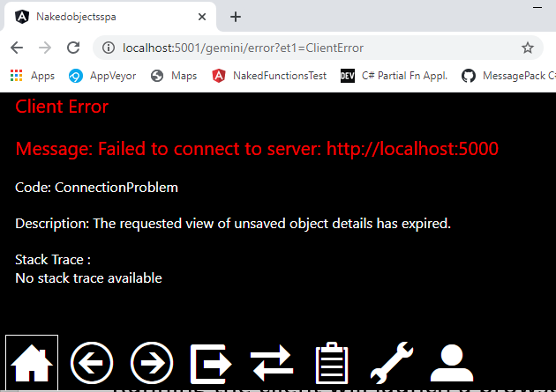
A Naked Functions application consists of two solutions: Server and Client
During development, it is best to run these two solutions in parallel, from two separate instances of Visual Studio
Download the ‘Template’ Client solution from: https://github.com/NakedObjectsGroup/NakedObjectsFramework/tree/master/Template/SPA%20Client
Running the client will launch a browser
We recommend using Chrome
After a short delay the client will state that it cannot access the server

Slide 7
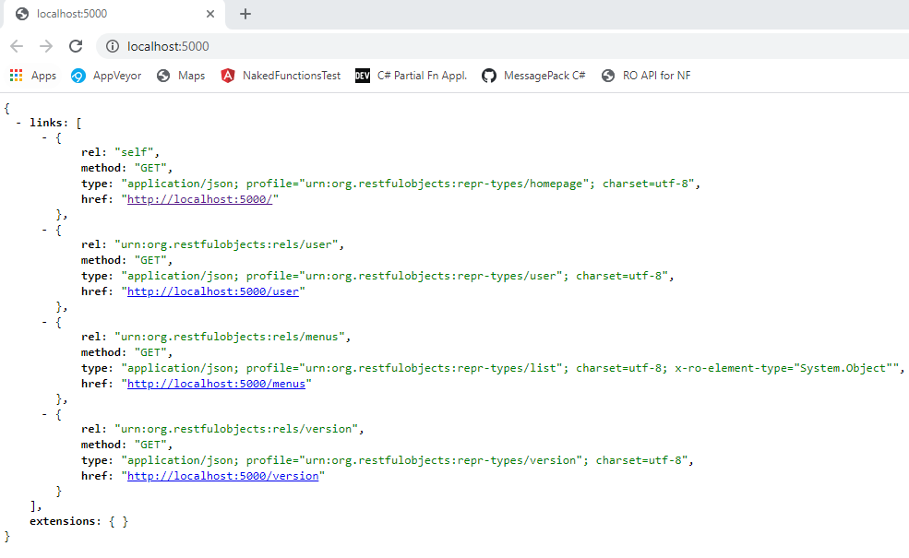
For the Server…
Download the ‘Template’ Server solution, from: https://github.com/NakedObjectsGroup/NakedObjectsFramework/tree/master/Template/Naked%20Functions%20Server
Running the server will launch its own browser showing the JSON Home representation of the RESTful API:
Shown here in Chrome with the JSON formatted by JSONView
But there is no need to be able to read or even view the JSON directly.

Slide 8

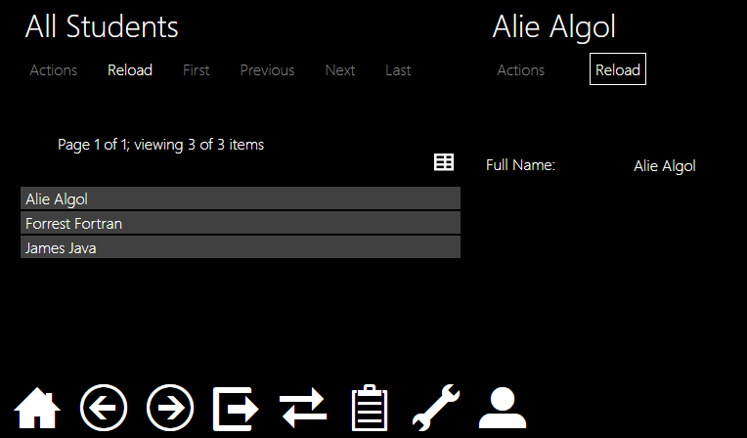
With the Server running, click Home ( ) on the Client
Then open the Students menu, click on All Students, then right-click on one of the returned list…

Slide 9
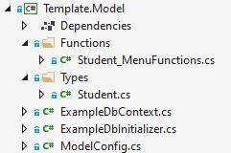
Explore the classes in the Model project:
1. Static class defining standalone functions that make up the Students menu
2. Record defining the Student type
3. Standard Entity Framework classes to manage persistence
4. ModelConfig is how the Server project reads the capabilities of the Model. (Explained on next slide.)

Slide 10
ModelConfig is how the Server ‘reads’ the capabilities of the model
public static class ModelConfig { public static Type[] Types() =>
public static Type[] Functions() =>
public static Type[] MainMenus() =>
public static Func<IConfiguration, DbContext> DbContextInstaller =>
}
1. Return an array of all domain types (record, interface, enum). The array may be constructed manually, or generated reflectively based on naming or namespace conventions.
2. Return an array of all static classes that define (public) domain functions, whether ‘main menu’ or ‘type-contributed’ functions. Used by the framework to build the meta-model of all user actions.
3. Return an array of static classes that define just the main menus. (Used by the framework to construct the actual menus).
4. Return a Func that, when invoked by the framework at the appropriate point in the start-up sequence, will generate and return a DbContext.

Slide 11
A default implementation of ModelConfig is supplied with the template:
1. Returns all non-static types from the model found in this namespace. (Change the namespace if you wish.)
public static class ModelConfig { public static Type[] Types() => DomainClasses.Where(t => t.Namespace == "Template.Model.Types" && !t.IsStaticClass()).ToArray();
public static Type[] Functions() => DomainClasses.Where(t => t.Namespace == "Template.Model.Functions" && t.IsStaticClass()).ToArray();
public static Type[] MainMenus() => Functions().Where(t => t.FullName.Contains("MenuFunctions")).ToArray();
public static Func<IConfiguration, DbContext> DbContextInstaller => c => new ExampleDbContext(c.GetConnectionString("ExampleCS"), new ExampleDbInitializer()); }
2. Returns static types from the model found in this namespace (Change the namespace if you wish.)
3. Returns those static types defined in 2, where the name contains ‘MenuFunctions’. (Use a different convention if you wish.)
4. Returns a lambda that creates a new ExampleDbContext, with the connection string (defined in the Server > appsettings.json), and the ExampleDbInitializer. (Change any names as needed.)

Slide 12
Things to try
(Read The Naked Functions programming model presentation first)
Adding new properties to the Student type
DateOfBirth, Address, or splitting the FullName into FirstName and LastName
Use [MemberOrder] to control ordering, [Mask("d")] to format the DateTime property nicely
Adding or modifying a menu function, to find students using new properties
Creating a new Student_Functions static type, with static functions taking this Student s as the first parameter
Use this pattern to allow properties of a student to be edited, for example

Slide 13
Create a new type e.g. Subject, remembering:
To work with Entity framework, all records need an Id property
All properties must be marked virtual
Needed by Entity Framework to permit ‘lazy loading’ of references
Record properties should have {get; init;} accessors
Collections must return ICollection<T> , and should be initialized
Override the ToString method to define a display title
Add these two lines of boilerplate code:
public override int GetHashCode() => base.GetHashCode();
public virtual bool Equals([NewTypeName] other) => ReferenceEquals(this, other);
(Entity Framework currently needs these - to handle records correctly).

